Slide 1
Advancing Renewable Energy and Energy Efficiency in the Commonwealth
An Innovative Partnership:
The Massachusetts Department of Environmental Protection
The Massachusetts Department of Energy Resources
__________________________________________________
Commissioner Kenneth Kimmell, MassDEP
New England Electricity Restructuring Roundtable
February 17, 2012

Slide 2
Clean Energy Results Program
New Chapter in Integrating Energy and Environment
New Role for MassDEP
Unique MassDEP/DOER Partnership
Launched November 16, 2011

Slide 3
Why is the Program Needed?
Help Meet Commonwealth Clean Energy Goals
Maximize MassDEP’s Expertise to Overcome Permitting & Siting Obstacles
Address Public Health Concerns and Misconceptions Using Sound Science
Promote Clean and Efficient Sources of Energy at MassDEP Regulated Sites

Slide 4
CERP Activities and Goals
Wastewater and Drinking Water Utilities
Organics to Renewable Energy
Environmentally Challenged Land
Wind Outreach and Education

Slide 5
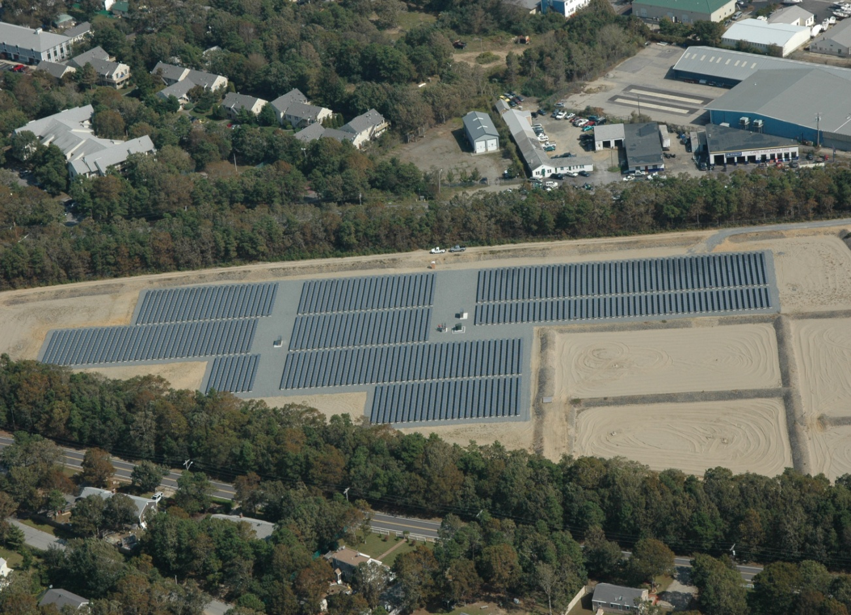
CERP Water Utility Goals
2013 -- Increase Renewable Energy by 50%
2020 -- Achieve Zero-Net Energy Use at 20% of Facilities
Steps to Achieve Goal:
Benchmark Energy Use at All MA Facilities
Assess Zero-Net Energy Potential at All MA Facilities
Barnstable Wastewater Treatment Plant
Notes:
I can provide notes on:
Background Facts: 370 Water Utilities, $150 Million/Year in Energy Costs, 1 Billion kWhs Used, 1 million of CO2
- Goal to have 74 (20%) at ZNE by 2020
Energy Pilots 2007 Summary: 14 pilot programs, etc
Energy Leaders Program: 85 participating facilities, etc

Slide 6
CERP Progress
Energy Use Benchmarked at 160 facilities
43% Towards CERP Goal
Renewable Energy Use Increased at 27 Energy Leaders Facilities
32% Towards CERP Goal
4 Facilities At or Near Zero-Net Energy
Falmouth, Lee, Pittsfield, Barnstable

Slide 7
STATE REVOLVING FUND
2 % loans
In latest intended use plan:
Of the $163.8 million on the Clean Water recommended list, $80 million is allocated for Green Project components
Of the $84.7 million on the Drinking Water recommended list, $44 million is provided for Green Project components.

Slide 8
Organics to Renewable Energy
We generate 1 million TPY organic waste
Landfills generate GHGs
Incineration generates GHG and other pollutants
Solution: divert organics

Slide 9
Organics to Renewable Energy
CERP 2020 Goals:
Divert an additional 350,000 tons per year of organic material from landfills and incinerators
Increase energy production from aerobic and anaerobic digestion to 50 megawatts (375 GWh/year)—80% capacity factor

Slide 10
Address Regulatory Barriers
Amendments to Solid Waste Site Assignment Regulations
Establish Clear Permitting Pathways
Amendments to Wastewater Treatment Regulations
Allow WWTP to Accept Organics for Processing
Progress: Draft Regulations Issued (final expected Spring 2012)
Notes:
4 Point Plan: Address Regulatory Barriers

Slide 11
Infrastructure for Organics Diversion
Address Collection Barriers
Pilot Collection Systems
Progress: Cambridge, Worcester, Devens, Grocery Store certifications
Establish Waste Ban
Commercial/Institutional Food Waste
Progress: Draft Plan to Promulgate Regulations
Notes:
(Points 2-3): Collection Barriers and Waste Ban

Slide 12
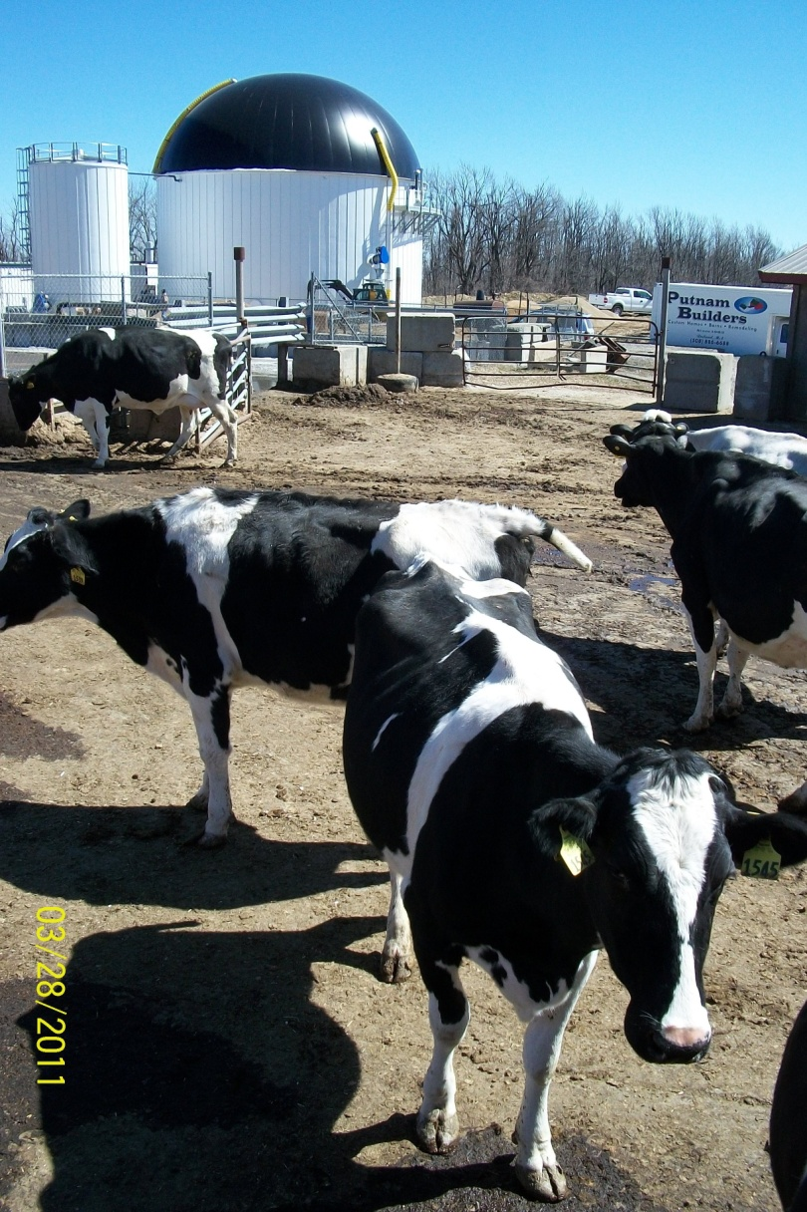
Project Siting
Identify AD/CHP Sites
State Land
Wastewater Treatment Plants
Progress: Study Underway of Appropriate Sites
Issue RFPs by 12/12
Ensure 3 Projects Operational by 2015
Monitor Environmental Performance
Progress: DCAM Partnership
Notes:
4) Siting

Slide 13
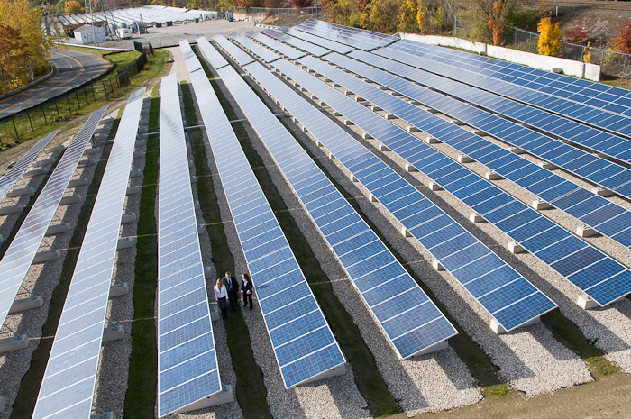
Environmentally Challenged Property
Achieve 50+ MW of Clean Energy on Closed Landfills, Brownfields, and Superfund Sites (by 2020)
Promote the Use of Green Remediation
WMECO Pittsfield

Slide 14
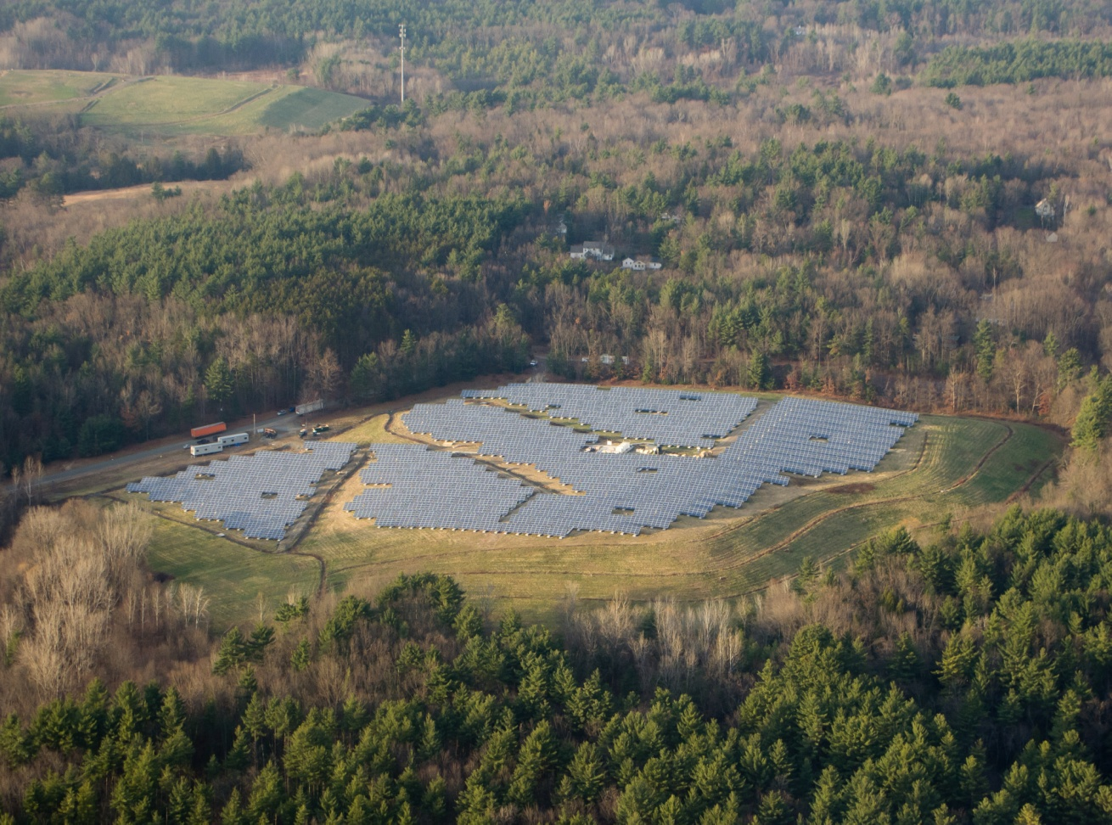
Clean Energy on Closed Landfills
Total 46+ MW permitted since 7/10
Progress: 30+ MW Permitted Under CERP since 7/11
9 Projects permitted in December alone!
Easthampton Landfill 2.3MW

Slide 15
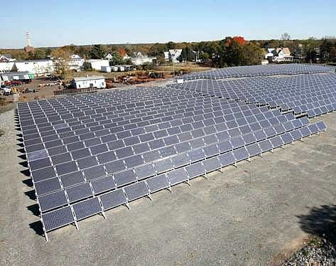
Brownfields
Progress:
14+ MW Sited on Brownfields
5+ Superfund Sites Evaluated for Green Remediation
Liability Guidance Developed
Brockton Brightfields Site

Slide 16
CERP Goals: Wind
Wind Turbine Health Impact Study: Report of the Independent Panel
Review MassDEP Noise Policy Guidance Relating to Wind Turbines

Slide 17
Goals of the Wind Turbine Health Impact Study
To proactively address health concerns raised by the public about wind turbine exposures.
To convene an independent panel of experts to review existing information of documented or potential health impacts associated with proximity to wind turbines.
To generate a report to advance public dialogue on the issues using the best available science.

Slide 18
Process
Scope of work developed; expertise identified; and panel convened.
The panel was composed of physicians and scientists with broad expertise in areas including acoustical noise/infrasound, public health, sleep disturbance, mechanical engineering, epidemiology, and neuroscience.
Public comments were solicited in June and July, 2011.

Slide 19
Jeffrey Ellenbogen, MMSc, MD Director of the Division of Sleep, MGH Department of Neurology, Sleep Medicine Program Assistant Professor, Harvard Medical School | Expertise MD, Neurology, Sleep Medicine Masters in Medical Science BA
Sheryl Grace Associate Professor of Mechanical Engineering Boston University College of Engineering | PhD Aerospace and Mechanical Engineering MS Aerospace and Mechanical Engineering MS Applied Mathematics BS Applied Mathematics
Wendy J. Heiger-Bernays, PhD Department of Environmental Health Boston University School of Public Health (BU SPH) Chair, Lexington Board of Health | PhD Biochemistry BS Biology
James F. Manwell, Ph.D. Professor Director of the Wind Energy Center Department of Mechanical and Industrial Engineering University of Massachusetts | PhD Mechanical Engineering MS Electrical & Computer Engineering BA Biophysics
Dora Ann Mills, MD, MPH, FAAP Former State Health Officer, State of Maine (1996-2011) Public Health Physician and Pediatrician | MD, PhD MPH Harvard School of Public Health
Kimberly Sullivan, Ph.D. Research Assistant Professor Department of Environmental Health Boston University School of Public Health | PhD Behavioral Neuroscience BS Psychology
Marc Weisskopf, Sc.D. Assistant Professor Harvard School of Public Health Department of Environmental Health/Epidemiology | ScD, Epidemiology PhD Neuroscience

Slide 20
Process, Continued
Panelists worked independently and followed a process similar to the National Academy of Sciences protocol.
This process focuses on review of existing research and “weight-of-evidence” approach.
In addition to peer-reviewed and scientific literature, panelists considered media and popular literature, as well as public comments.
MassDEP and MDPH did not participate in panel deliberations or have any input on content.

Slide 21
Process, Continued
MassDEP and MDPH are currently reviewing the report.
The agencies are reviewing the findings;
And carefully considering the recommended best practices.
Public meetings will be held and comment period – through March 19, 2012.
Agencies will review and consider public comments before using the report’s findings.

Slide 22
Key Health Findings
The panel concluded that:
There is no evidence for a set of health effects from exposure to wind turbines that could be characterized as a "Wind Turbine Syndrome.”
Claims that infrasound from wind turbines directly impacts the vestibular system have not been demonstrated scientifically. Available evidence shows that the infrasound levels near wind turbines cannot impact the vestibular system.
The weight of the evidence suggests no association between noise from wind turbines and measures of psychological distress or mental health problems.
None of the limited epidemiological evidence reviewed suggests an association between noise from wind turbines and pain and stiffness, diabetes, high blood pressure, tinnitus, hearing impairment, cardiovascular disease, and headache/migraine.

Slide 23
Key Health Findings
Shadow Flicker: The panel concluded that:
Evidence suggests that shadow flicker does not pose a risk for eliciting seizures.
There is limited evidence of an association between annoyance from prolonged shadow flicker (exceeding 30 minutes per day) and potential transitory cognitive and physical health effects.
Ice Throw: The panel concludes that:
Falling ice is physically harmful and measures should be taken to ensure the public will not encounter such ice.

Slide 24
Key Health Findings
Noise/Vibration: The panel concluded that:
There is limited epidemiologic evidence suggesting an association between exposure to wind turbines and annoyance. There is insufficient epidemiologic evidence to determine whether there is an association between noise from wind turbines and annoyance independent from the effects of seeing a wind turbine and vice versa.
There is a possibility that noise from some wind turbines can cause sleep disruption. Sleep disruption has been shown to adversely affect mood, cognitive functioning, and overall sense of health and well-being, based on sound sources other than wind turbines.

Slide 25
Best Practices: The Panel Recommends:
Noise limits be included as part of a statewide policy for new wind turbines installations. Also recommends an ongoing program of monitoring and evaluating the sound produced by wind turbines.
Shadow flicker should not occur more than 30 minutes per day and not more than 30 hours per year at the point of concern.
Activities in the vicinity of a wind turbine should be restricted during & immediately after icing events. Ice control measures for blades should be considered/demonstrated to work.
Public participation should be encouraged for projects: directly involve residents in close proximity to projects. Engage the public through education and other incentives.

Slide 26
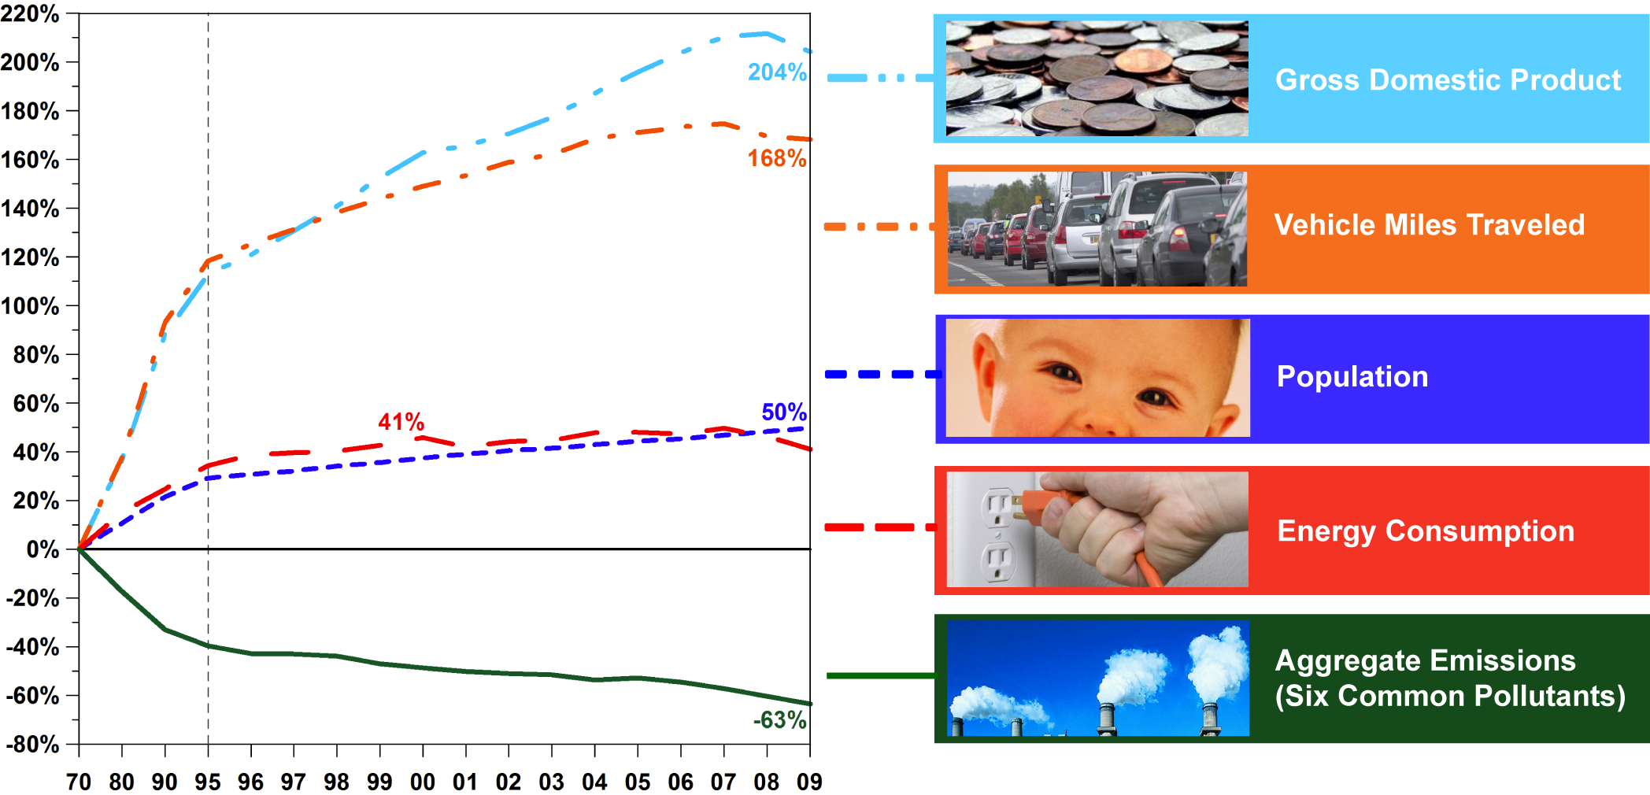
Cleaner air and a growing economy

